Slide 1

Applied Optimization Case 3
Optimizing Financial Return
Group 5
Somer Sinnard, Daniel Szabo
& Grant Wheeler

Slide 2
Overall Objective
Determine optimal portfolios given various conditions.

Slide 3
Question 1: Part 1
For the period 2000-2017, given a portfolio comprised of
30% Russell 1000 index
15% Russell 2000 Value index
15% Russell 2000 Growth index
20% Barclays US Govt Bond index
20% Barclays Investment Grade Bond index
What were the average return and standard deviation of this portfolio?
How does this compare to the broad market? (Wilshire 5000)

Slide 4

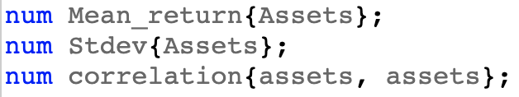
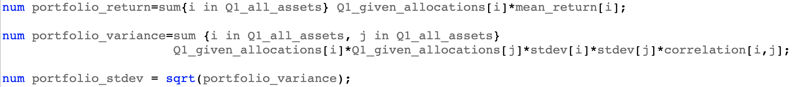
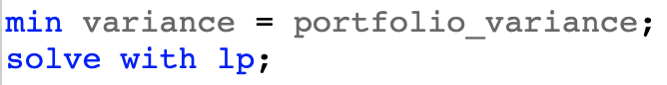
GENERAL SETUP
Define the set of Assets:
Create numbers:
Read in the Data from Excel Table:
Create Numbers to perform calculations:
Minimize variance and solve with Linear Programing:
Notes:
Declare string sets of assets for all assets in data file
Declare numbers to correspond to mean return, st dev, and correlation for all assets from the two excel sheets
Read data from excel sheets into our declared numbers
Declared numbers for return, variance, and standard deviation to correspond to entire portfolio by working allocation variable into the formulations
Minimize total variance and solve with LP

Slide 5
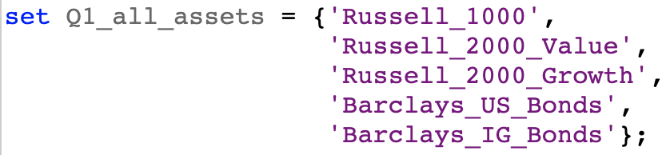
SETUP
Declared set of assets found in the given portfolio:
Assigned each asset its corresponding allocation amount:
Notes:
Solved with LP

Slide 6
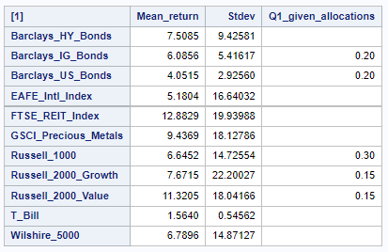
Q1:Part 1 Results
Portfolio Return: 6.8698
Portfolio Standard Deviation: 9.9656
Broad Market Return: 6.7896
Broad Market Standard Deviation: 14.8713
Similar average returns when compared to the broad market
Smaller Standard Deviation

Slide 7
Question 1: Part 2
For the average return obtained in Part 1, how much could the standard deviation have been reduced using the same assets while maintaining a 60/40 split between stocks and bonds?
How much could the standard deviation have been reduced using the same assets but dropping the 60/40 balance constraint?

Slide 8
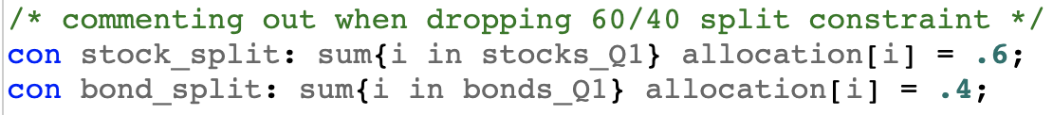
Setup CHANGES
Declaring sets for all assets, stock assets, and bond assets:
Non-negativity for allocations:
Allocations must sum to 1 and fixing portfolio return to value from part 1:
60% stocks, 40% bonds constraint:
Solve with NLP instead of LP:
Notes:
Declared three sets, one for the stock assets, one for the bond assets, and one to encompass all examined assets
Enforced non-negativity for our allocations as no short positions are allowed
Enforced rule that sum of all asset allocations must equal 1 and set our required return to equal the return we previously obtained
Implemented constraints to force stock allocations to stay under 60% and bond allocations to stay under 40%

Slide 9
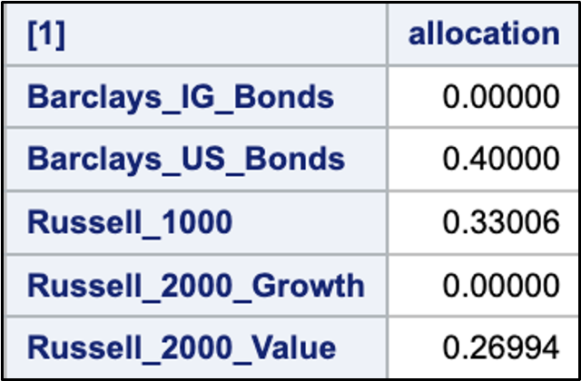
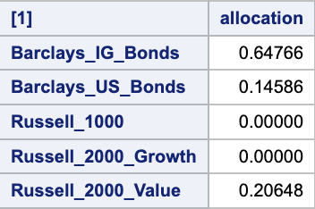
Q1:Part 2 Results
Allocations with 60/40 constraint:
 | Min Standard Deviation | Difference from Q1 P1
Question 1 Part 1: | 9.9656 | -
With 60/40 Constraint: | 8.9576 | -1.008
Without 60/40 Constraint: | 5.597 | -4.3686
Allocations without 60/40 constraint:

Slide 10
Question 2
For the period 2000-2017 given a portfolio comprised of
Russell 1000 index
Russell 2000 Value index
Russell 2000 Growth index
Barclays US Govt Bond index
Barclays Investment Grade Bond index
annual average returns between 4.25% and 11%
What is the efficient frontier for this set of assets?

Slide 11
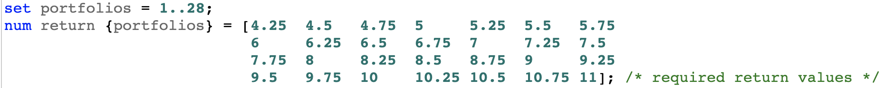
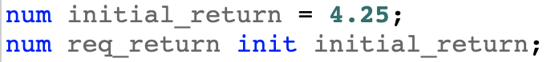
Setup ChANGES
Solving a sequence of portfolio optimizations:
Initializing required return to our lowest return in the range:
Notes:
Declared three sets, one for the stock assets, one for the bond assets, and one to encompass all examined assets
Enforced non-negativity for our allocations as no short positions are allowed
Enforced rule that sum of all asset allocations must equal 1 and set our required return to equal the return we previously obtained
Implemented constraints to force stock allocations to stay under 60% and bond allocations to stay under 40%

Slide 12
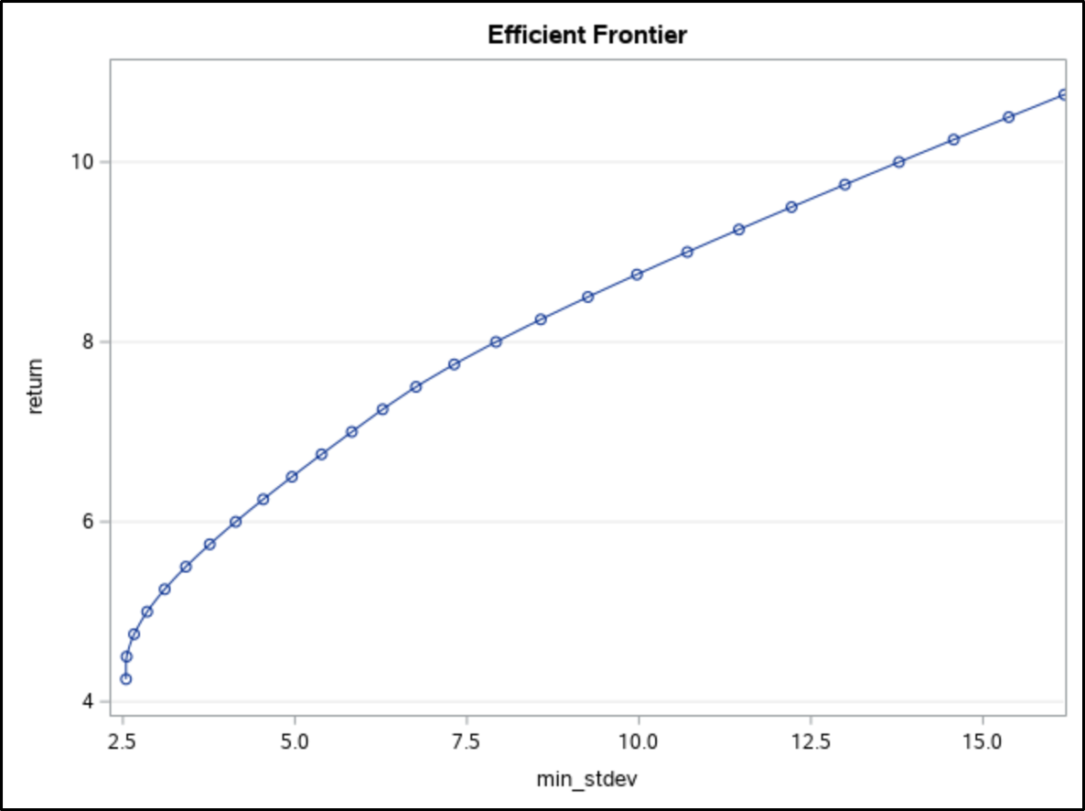
Efficient Frontier
Min Standard Deviation | Return
2.5462 | 4.25%

Slide 13
Question 3
For the period 2000-2017 given a portfolio comprised of
Russell 1000 index
Russell 2000 Value index
Russell 2000 Growth index
Barclays US Govt Bond index
Barclays Investment Grade Bond index
Additional Assets:
GSCI Precious Metals index
MSCI EAFE index
FTSE REIT index
Barclays High-Yield Index
annual average returns between 4.25% and 11%
What is the efficient frontier for this set of assets?

Slide 14
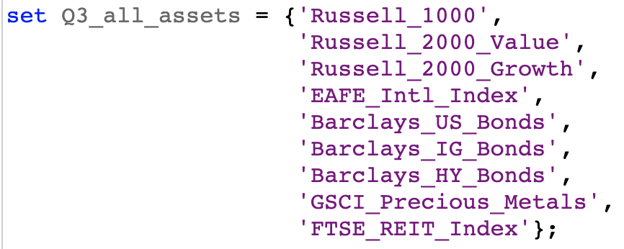
Setup CHANGEs
Included additional assets in our new asset set:

Slide 15
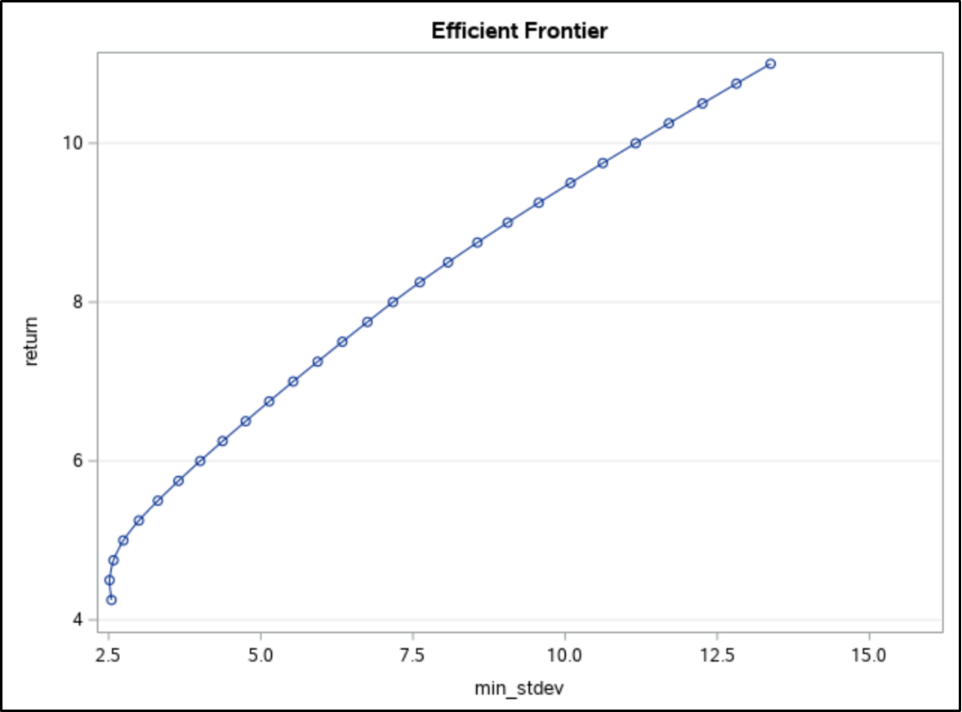
Efficient Frontier
Min Standard Deviation | Return
2.5145 | 4.50%

Slide 16
Question 4
T-Bills now additional investment option
Same set of assets as before
Short position allowed for T-Bills only
What effect does this have on the efficient frontier for this set of assets?

Slide 17
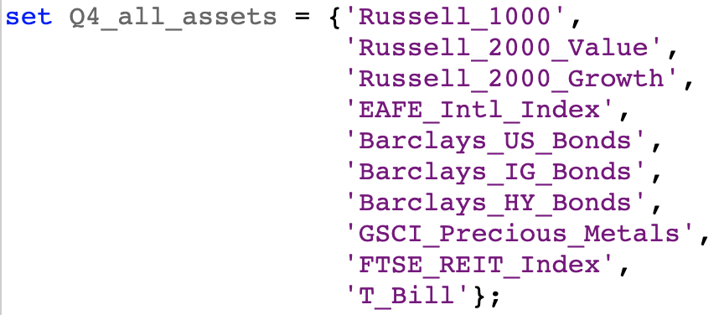
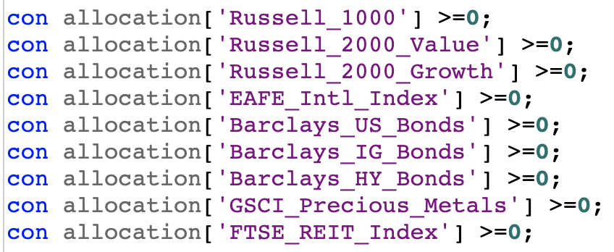
Setup CHANGES
Included T-bills in our new asset set:
Constrained all assets other than T-bills to be non-negative:
Notes:
Declared three sets, one for the stock assets, one for the bond assets, and one to encompass all examined assets
Enforced non-negativity for our allocations as no short positions are allowed
Enforced rule that sum of all asset allocations must equal 1 and set our required return to equal the return we previously obtained
Implemented constraints to force stock allocations to stay under 60% and bond allocations to stay under 40%

Slide 18
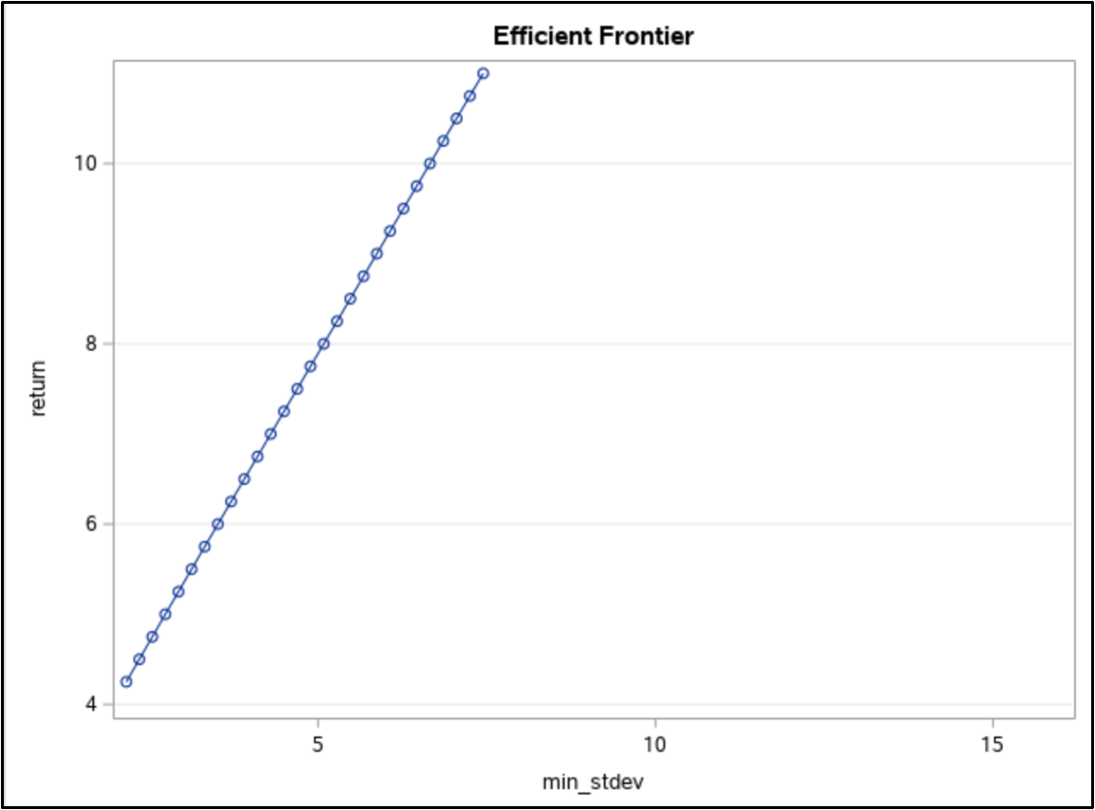
Efficient Frontier
Min Standard Deviation | Return
2.1605 | 4.25%

Slide 19
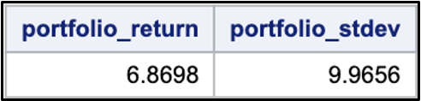
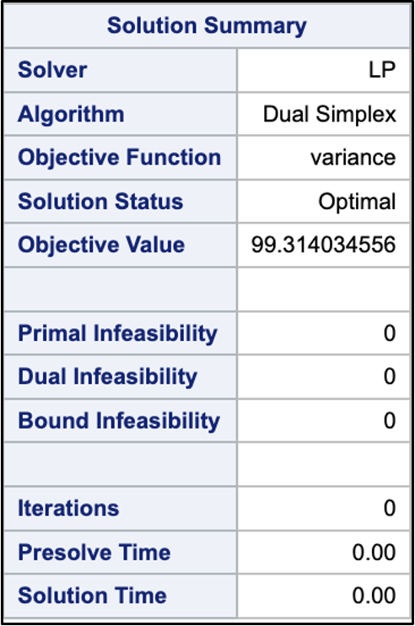
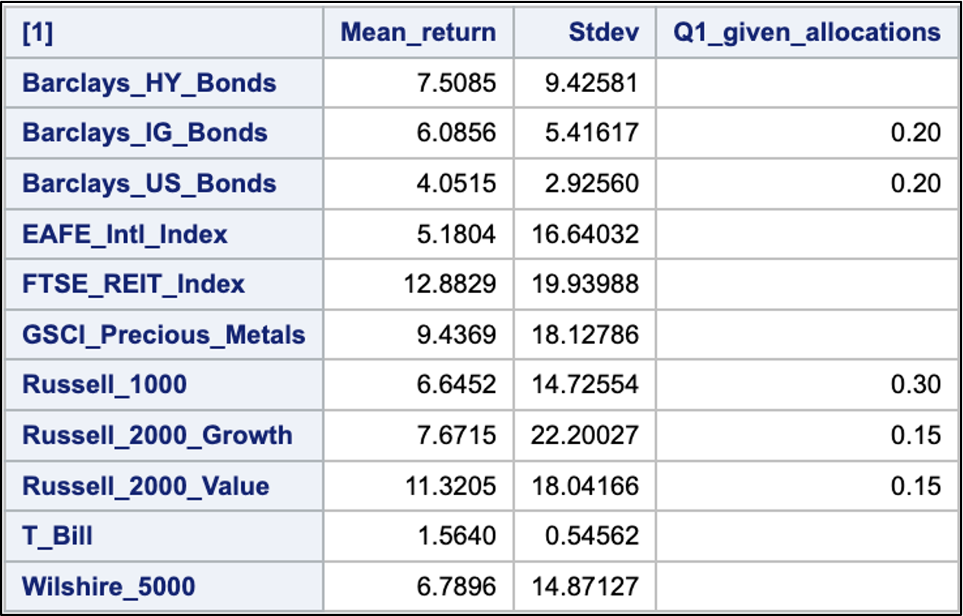
APPENDIX: Question 1 Part 1

Slide 20
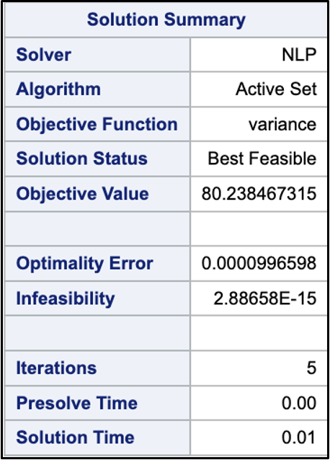
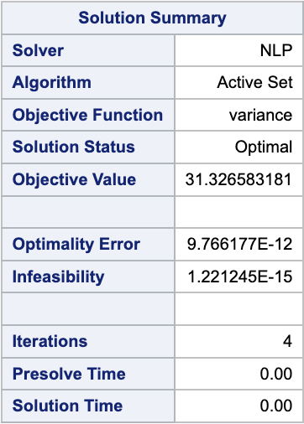
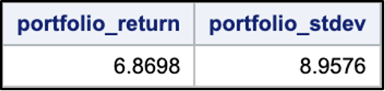
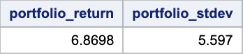
APPENDIX: Question 1 Part 2
60/40 Constraint:
No 60/40 Constraint:

Slide 21
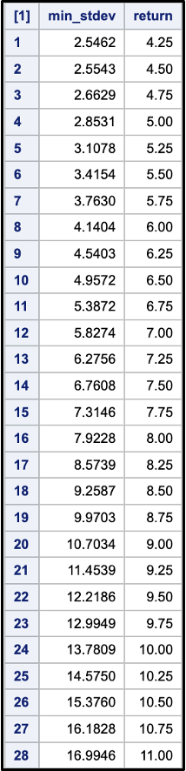
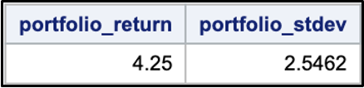
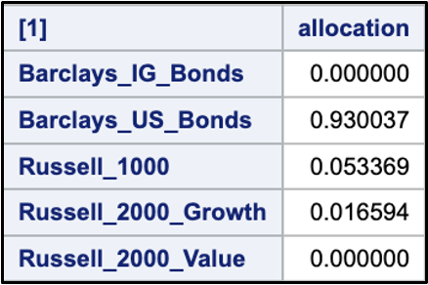
APPENDIX: Question 2

Slide 22
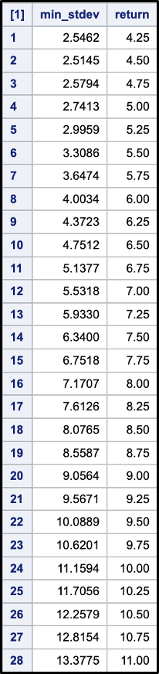
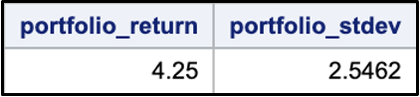
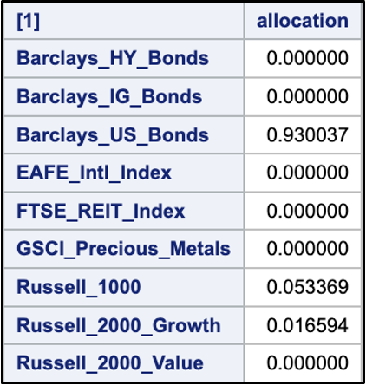
APPENDIX: Question 3

Slide 23
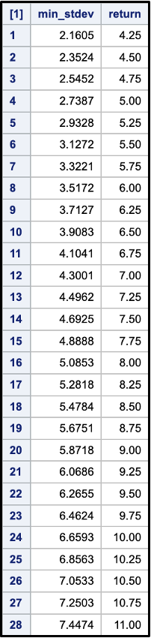
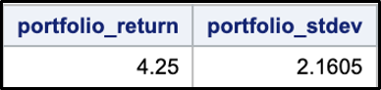
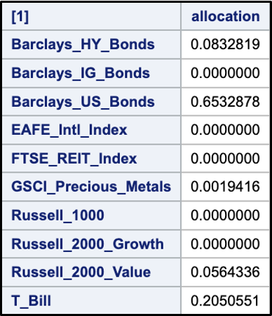
APPENDIX: Question 4

